Slide 1

NYPD Arrest Data Analysis:
Offense Severity Across NYC
Group Members: Aysha Mukhtar, Anthony Jerez-Tenecela, Jahed Ullah, Youssef Moussa

Slide 2

Abstract
>Analyze 2025 NYPD Arrest Data
>Focus: How offense severity varies by age, borough, and date
>Offense categories: Felony, Misdemeanor, Violation
>Methods:
EDA, feature engineering
Applied multiple classifiers (Logistic, Tree, Forest, KNN)
Built an ensemble voting model
>Key Findings:
Age & borough affect offense severity
Serious crimes spike during specific days/months

Slide 3
Introduction/Research Questions
>Motivation & Background
71,000+ arrests recorded in 2025 NYC
Dataset includes offense level, date, location, age, race, gender
Offense level = key metric of crime severity
Goal: Identify trends to support fair, data-driven policing and public safety
>Key Questions
What levels of offense are most commonly associated with different age groups?
How does the level of offense vary across boroughs in New York City?
Are there specific times such as month and weekday when higher level offenses are more likely to occur?

Slide 4

Real-World Implementation
Inform patrol scheduling and youth intervention programs
Help city leaders identify neighborhood specific needs
Uncover potential disparities in arrests
Contribute to more equitable and effective public safety plans

Slide 5
Data Description
>Source: NYPD Arrest Data (Year to Date) from NYC Open Data
>Imported via GitHub CSV into Google Colab
> Key features: AGE_GROUP, ARREST_BORO, ARREST_DATE, LAW_CAT_CD
>Target variable: LEVEL_OF_OFFENSE (felony, misdemeanor, violation)

Slide 6
Research Approach
EDA:
Summary statistics, null checks, visualizations
Cleaning:
Handle missing values, convert dates
Feature Engineering:
One-hot encoding, time-based features (month, weekday)
Modeling:
3 core models: Logistic Regression, Decision Tree, Random Forest
additional models: KNN
Ensemble Voting Classifier
Evaluation:
Accuracy, Precision, Recall, ROC-AUC
Chi-square tests for categorical relationships

Slide 7
EDA Visualizations

Slide 8
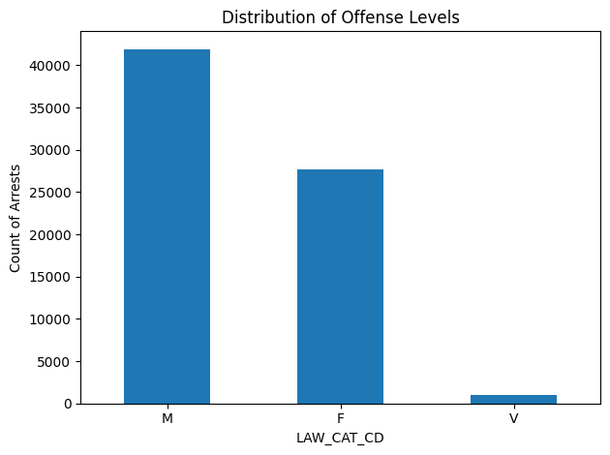
Class Distribution
Based on the plot, a majority of the offense levels recorded are misdemeanors and felonies.

Slide 9
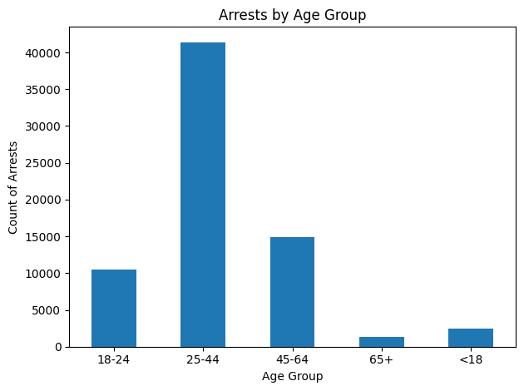
Arrests by Age Group
Based on the above plot, a majority of the arrests were made on young adults - middle aged adults that fall within the age group of 25-44. Only a selective few arrests were made age groups < 18 and 65+.

Slide 10
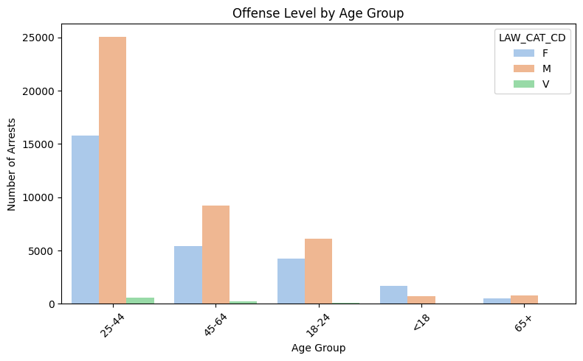
Offense Level by Age Group
The 25-44 age group is the most represented across all offense levels, especially for felony (F) and misdemeanor (M) arrests.
Younger individuals (<18) and older individuals (65+) account for far fewer arrests, suggesting offenses are concentrated among middle-aged adults.
Felonies and misdemeanors are the dominant categories in all age groups, with very few violations (V).
Insight for RQ1: Most offenses, particularly felonies and misdemeanors, are associated with individuals aged 25-44.

Slide 11
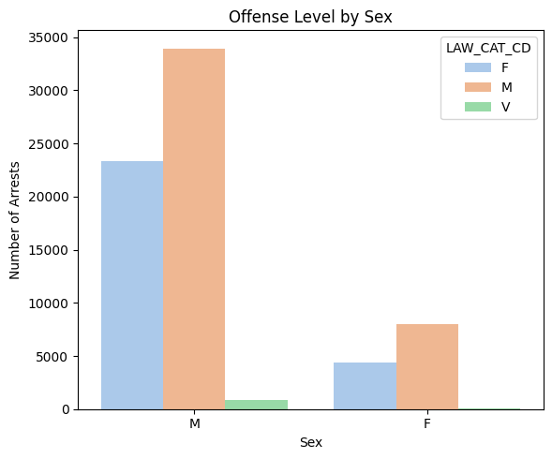
Offense Level by Sex
Males contributed to the majority of the recorded crimes which mostly included misdemeanors and felonies.
Compared to males, females committed fewer crimes and little to no violations.

Slide 12
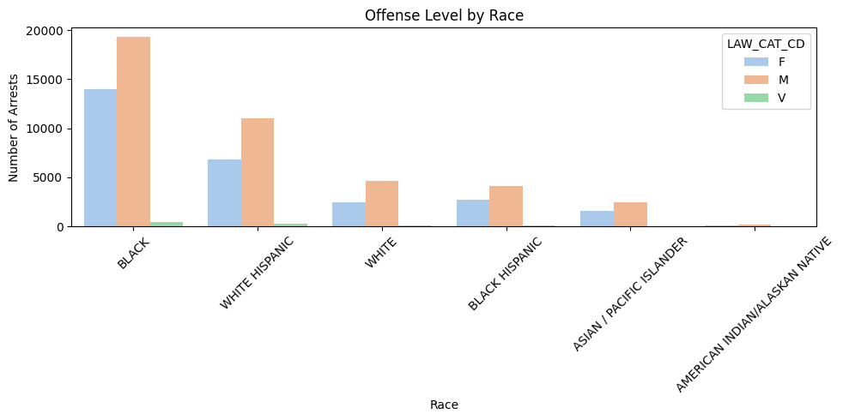
Offense Level by Race
Individuals that identify as black and white hispanic committed a majority of the recorded crimes, which mostly included felonies and misdemeanors.
More misdemeanors were committed compared to felonies.
There is a recurring trend that shows that violations were not committed as much.

Slide 13
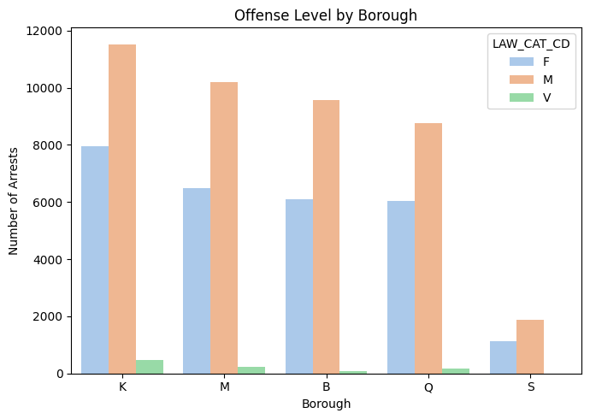
Offense Level by Location
Brooklyn (K), Manhattan (M), and Bronx (B) have the highest numbers of arrests.
Again, felonies and misdemeanors dominate the distribution in every borough.
Staten Island (S) has the lowest number of arrests overall.
Insight for RQ2: Felonies and misdemeanors occur across all boroughs but are most frequent in Brooklyn, Manhattan, and the Bronx.

Slide 14
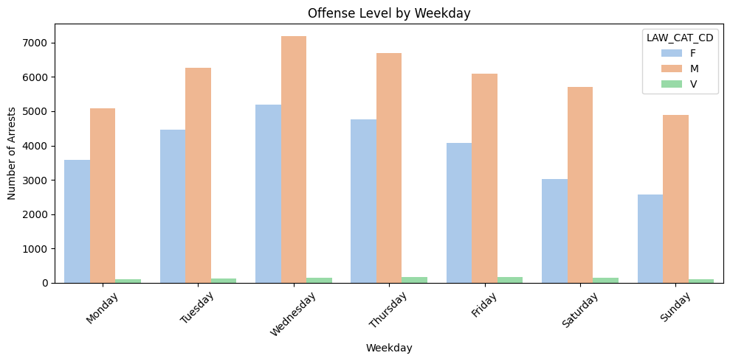
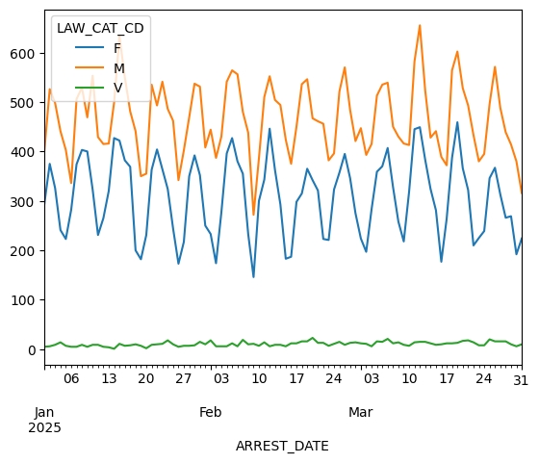
Offense Level by Time
Wednesday has the highest number of arrests, and again, felonies and misdemeanors are the most common.
Insight for RQ3: Offenses are slightly more frequent midweek (especially Wednesday), but levels remain fairly consistent across weekdays.
Felonies and Misdemeanors show similar temporal patterns, with spikes and dips occurring on the same dates. This suggests a potential correlation in how these offense levels fluctuate over time, possibly due to shared causes.
Violations, on the other hand, remain relatively constant over time.

Slide 15
📊 Feature Engineering
Removed invalid values in LAW_CAT_CD such as "I" and "9"
Encoded categorical features (e.g., borough, age group, weekday, month)
Scaled numerical features to prepare for ML models
Created new features from datetime: weekday, hour, month

Slide 16
Chi-Square Feature Selection
Used Chi-Square test to evaluate association between categorical features and LAW_CAT_CD
Identified most statistically significant predictors:
Age group
Borough
Month
Weekday
Helped reduce noise and improve model focus

Slide 17
Models

Slide 18
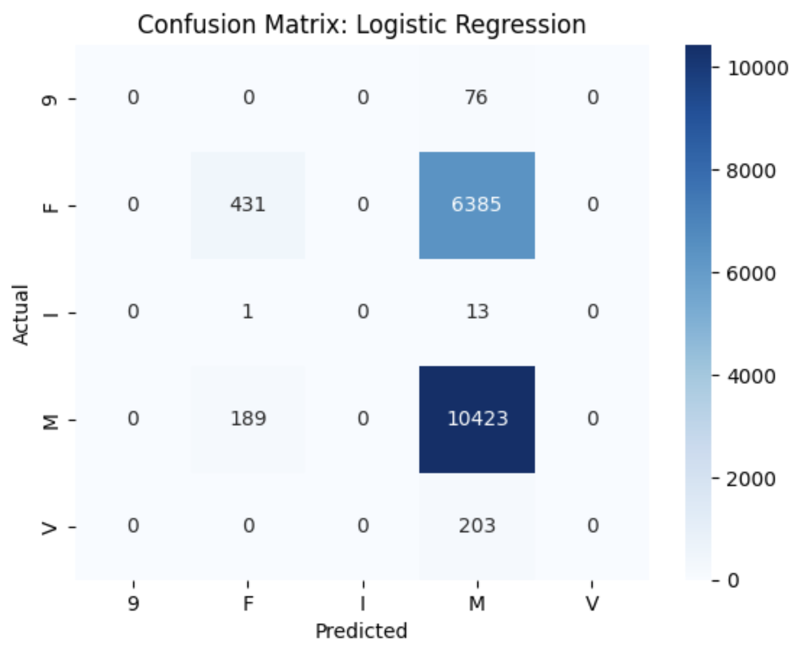
Logistic Regression
Logistic Regression struggles significantly with minority classes like 9, I, and V, where precision, recall, and F1-scores are all 0.00.
Class M is predicted with high recall (0.98), indicating the model is defaulting to this class in most predictions.
The low macro average indicates poor performance across classes, showing that the model is not generalizing well for multiclass classification.
This performance limitation is expected since Logistic Regression assumes linear decision boundaries and lacks mechanisms for handling class imbalance, especially in high-dimensional, categorical datasets like this one.

Slide 19
Models
📊 Logistic Regression Results : Accuracy: 0.9008562204650727
Decision Tree Results: Accuracy: 0.993309315491508
Random Forest Results: Accuracy: 0.9921864034061667
KNN Results: Accuracy: 0.9702428297384551

Slide 20
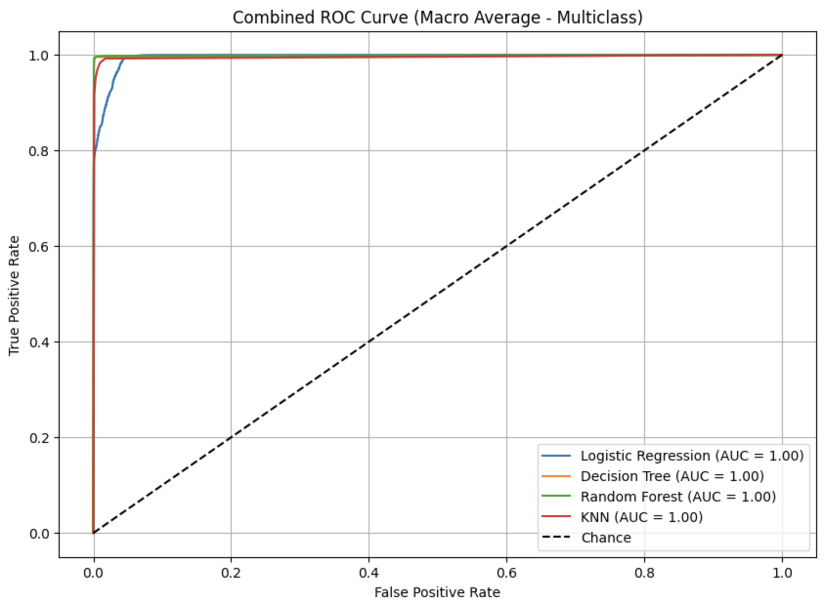
📈 ROC-AUC Scores
Logistic Regression: 0.9905
Decision Tree: 0.9222
Random Forest: 0.9489
KNN: 0.9114
Ensemble Voting Classifier: ~0.9859 (based on overall metrics)

Slide 21
Classification Reports – Summary
Logistic Regression:
Poor performance on minority classes
High weighted avg only due to dominant classes
Decision Tree / Random Forest:
Strong performance across all classes
High precision and recall even on underrepresented groups
KNN:
Performs decently but struggles with rare labels
Voting Classifier:
Balanced best traits of each model
Achieved accuracy of 98.59% and best overall class-level metrics

Slide 22
Conclusion
Research Questions Answered:
Levels of offense most associated with age groups: Younger individuals (18–30) had more misdemeanors (M), while older groups skewed toward violations (V)
Borough impact: Manhattan and Brooklyn had more felonies (F), while Queens and Staten Island had fewer
Time trends: Higher-level offenses (F) were more common on weekdays and in summer months (June–August)
Modeling Outcome:
Ensemble Voting Classifier was the best overall
Random Forest was the most interpretable and consistent
Logistic Regression was least effective due to class imbalance
Future Work:
Improve minority class representation (e.g., SMOTE or class weighting)
Incorporate geospatial data (precincts, coordinates)
Analyze longitudinal crime trends over multiple years

